Slide 1
Scientific Revolution
1550 CE – 1800 CE

Slide 2
Background to Scientific Revolution
Until the 15th and 16th centuries, medieval scientists – known as “natural philosophers” – relied on the ancient works of Greece and works by Aristotle for their scientific knowledge
During the Renaissance, humanists mastered both Greek and Latin, which allowed them access to Roman works and works by people like Ptolemy, Archimedes, and Plato – all people who disagreed with Aristotle
Other developments also encouraged new ways of thinking – technical problems like how much weigh a ship could hold, and the invention of new instruments such as the telescope and microscope made fresh scientific discoveries possible
Another invention helped with the spread of new ideas – the printing press, which enabled new discoveries to be spread quickly throughout the western world
Mathematics also played a crucial role in the scientific revolution; there were numerous mathematicians in the scientific revolution who made discoveries and advances using mathematics

Slide 3
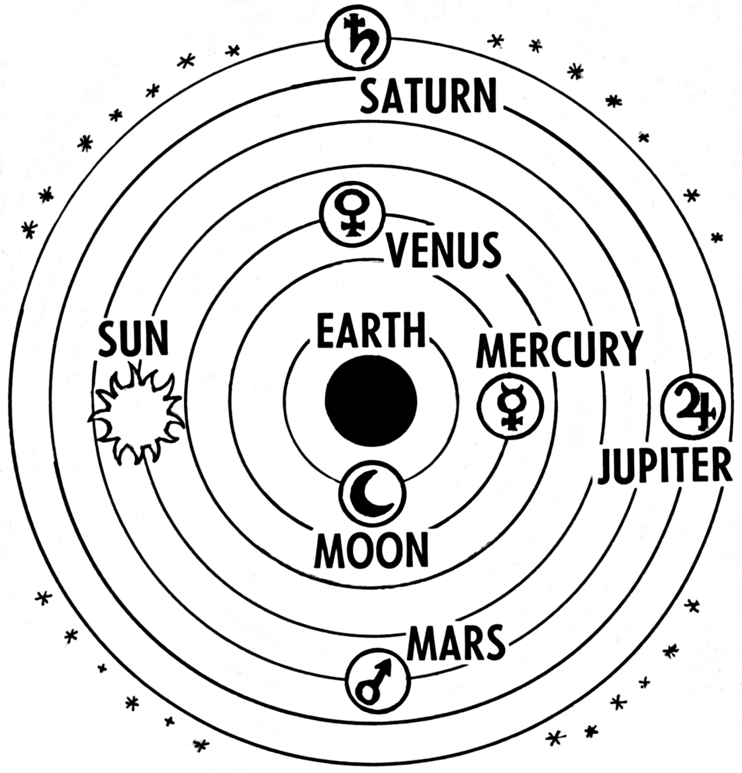
Scientific Revolution: Astronomy
Discoveries in astronomy would overturn the conception of the universe held by Westerners in the Middle Ages
Ptolemaic System – Ptolemy, who lived in the second century CE, was the greatest astronomer of antiquity; his ideas were used during the Middle Ages to construct a model of the universe that was geocentric – with the earth at the center, fixed and unmoving, while all the other planetary bodies revolved around the earth;
Ptolemy believed the universe was a series of concentric spheres – one inside the other; the spheres were made of a crystal-like transparent substance in which the heavenly bodies – pure orbs of light – were embedded; the moon was in the first sphere, Mercury in the second, Venus in the third and the sun in the fourth; beyond the tenth sphere was heaven, where God and all the saved souls resided – so God was at one end of the universe and humans at the other

Slide 4
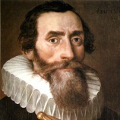
Scientific Revolution: Astronomy
In May 15643, Nicholas Copernicus published On the Revolutions of the Heavenly Spheres
Copernicus was a proponent of the heliocentric model, which had the sun at the center of the universe
Copernicus demonstrated that the sun was the center of the universe and that the planets revolved around the sun
He also demonstrated that the Moon revolved around the Earth
He also proved the Earth revolved on an axis while it was moving around the sun
Johannes Kepler used detailed astronomical data to arrive at his laws of planetary motion
He confirmed the sun was the center of the universe and showed the orbits of the planets were not circular but elliptical; this became known as Kepler’s first law
Copernicus
Kepler

Slide 5
Kepler’s Elliptical Model of the Solar System

Slide 6
Scientific Revolution: Galileo
Galileo Galilei taught mathematics and conducted regular observations of the heavens with a telescope
Galileo discovered mountains on the moon, four moons revolving around Jupiter, and sunspots
His observations destroyed the last element of the Ptolemaic system, because they demonstrated the heavenly bodies were not just orbs of light
Galileo published his findings in The Starry Messenger in 1610.
His findings got him in trouble with the Catholic Church, which told him to abandon the heliocentric model
The Church was threatened by this model, because it contradicted the idea that God created Earth and thus made it the center of the universe
By the 1630s and 40s, most scientists and astronomers accepted the heliocentric model of the universe
There was still the problem of explaining motion in the universe, as the ideas of Copernicus, Kepler, and Galileo had not been put together into one model; the problem would be solved by one of the greatest geniuses of the Scientific Revolution

Slide 7
Sir Isaac Newton
Isaac Newton was born in 1642; he attended Cambridge University and became a professor of mathematics
His major work, Mathematical Principles of Natural Philosophy, defined the three laws of motion that govern the planetary bodies and earth
He also wrote about the universal law of gravitation, which explains why planetary bodies do not go off in straight lines but instead continue in elliptical orbits around the sun;
The law states that every object in the universe is attracted to every other object by a force called gravity
Newton’s ideas created a new picture of the universe; it was now seen as one huge, regulated, uniform machine that worked according to natural laws
Newton’s ideas dominated the worldview until Einstein's theory of relativity created an even newer picture (more on him later in the semester!)

Slide 8
Scientific Revolution: Medicine
A revolution in medicine also began in the 16th century. Medicine in the late Middle Ages was dominated by the teachings of Galen, a Greek physician who had lived during the second century CE. Galen had arrived on animal rather than human dissection to arrive at a picture of human anatomy; he was often wrong
In 1543, Andrew Vesalius wrote On the Fabric of the Human Body, where he discussed dissecting human bodies while he was a professor of surgery at the University of Padua
Vesalius was able to present an accurate examination of the individual organs and human body, but he still believe Galen’s “two-blood” theory that said two kinds of blood flowed in veins and arteries (later disproved).
In 1628, William Harvey wrote On the Motion of the Heart and Blood, which was based on close observations and experiments. Harvey showed that the heart, not the liver, as Galen had thought – was the beginning point for the circulation of blood in the body. He also proved that the same blood flowed in both veins and arteries; he also showed that blood makes a complete circuit as it passes through the body

Slide 9
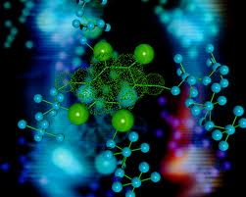
Scientific Revolution: Chemistry
Advancements were made in chemistry in the 17th and 18th centuries
Robert Boyle was one of the first scientists to conduct controlled experiments
His work on the properties of gases led to Boyle’s Law, which stated that the volume of a gas varies with the pressure exerted on it
Antoine Lavoisier invented a system of naming the chemical elements, much of which is still used today; he is regarded by many as the founder of modern chemistry

Slide 10
Women & the Origins of Modern Science
Women were also involved in the Scientific Revolution; one of the most prominent female scientists was Margaret Cavendish, who came from an aristocratic family
She wrote Observations Upon Experimental Philosophy, in which she was critical of the growing belief that humans could be the masters of nature
In Germany, many of the astronomers were women, most of whom worked in family observatories where they were trained by their families; between 1650 and 1710, women made up 14% of all German astronomers
The most famous female German astronomer was Maria Winkelmann. She married a practicing astronomer and became his assistant. She made some original contributions to astronomy, including the discovery of a comet
When her husband died, she applied for a position as an astronomer at the Berlin Academy, but was denied because she was a woman and lacked a university degree; they feared they would set a bad example by hiring a woman; her problems with the academy were felt by women all over Europe, who were not taken seriously as scientists

Slide 11
Descartes and Reason
The new conception of the universe strongly influenced the Western view of mankind.
The 17th century philosopher Rene Descartes wrote Discourse on Method, a book of philosophy that centered on the nature of humanity
He is famous for his principle “Cogito ergo sum” or “I think, therefore I am”. That is, because humankind can think, it thus exists.
He used this thought to arrive at his second principle, the mind cannot be doubted but the body and the material world can, the two must be radically different”. From this idea came the separation of mind and matter – and allowed scientists to view matter as separate from humankind, and thus able to be investigated and researched through reason – or human thought and observation
Descartes is called the father of modern rationalism, the system of thought that is based on the belief that reason is the chief source of knowledge

Slide 12
The Scientific Method
Sir Francis Bacon is credited as the person who created the Scientific Method
He believed inductive reasoning should be used to learn about nature
Inductive reasoning proceeds from the particular (narrow focus) to the general (broad focus)
The scientific method uses systematic observations and carefully organized experiments to lead test hypotheses and lead to correct general principles
Bacon believed that scientific reasoning could be used to conquer nature and give humans power over nature

Slide 13
Scientific Method
The scientific method is a systematic procedure for collecting and analyzing evidence. It was crucial to the evolution of science in the modern world.
Scientists always follow these steps when conducting experiments (if they don’t their work will be discredited).
An important point to remember is that a hypothesis may be correct or incorrect, and a scientist will need to follow these steps to “prove” it one way or another.

