Slide 1
Life after Napoleon

Slide 2
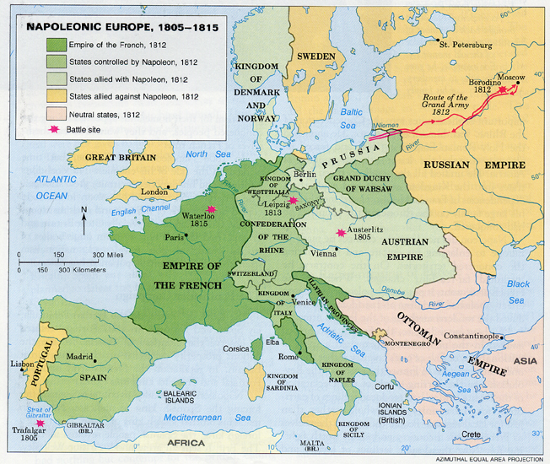

Slide 3
1815 - Western Europe
Conservative Order Throughout
Congress of Vienna - made peace at the end of Napoleonic wars - Key Players: Prussia, Russia, Britain, Austria, and France
Wanted to uphold Conservative Governments.
Great Britain didn’t want support - looking for New Markets (thanks IR)
Revolutions of Latin America are happening

Slide 4
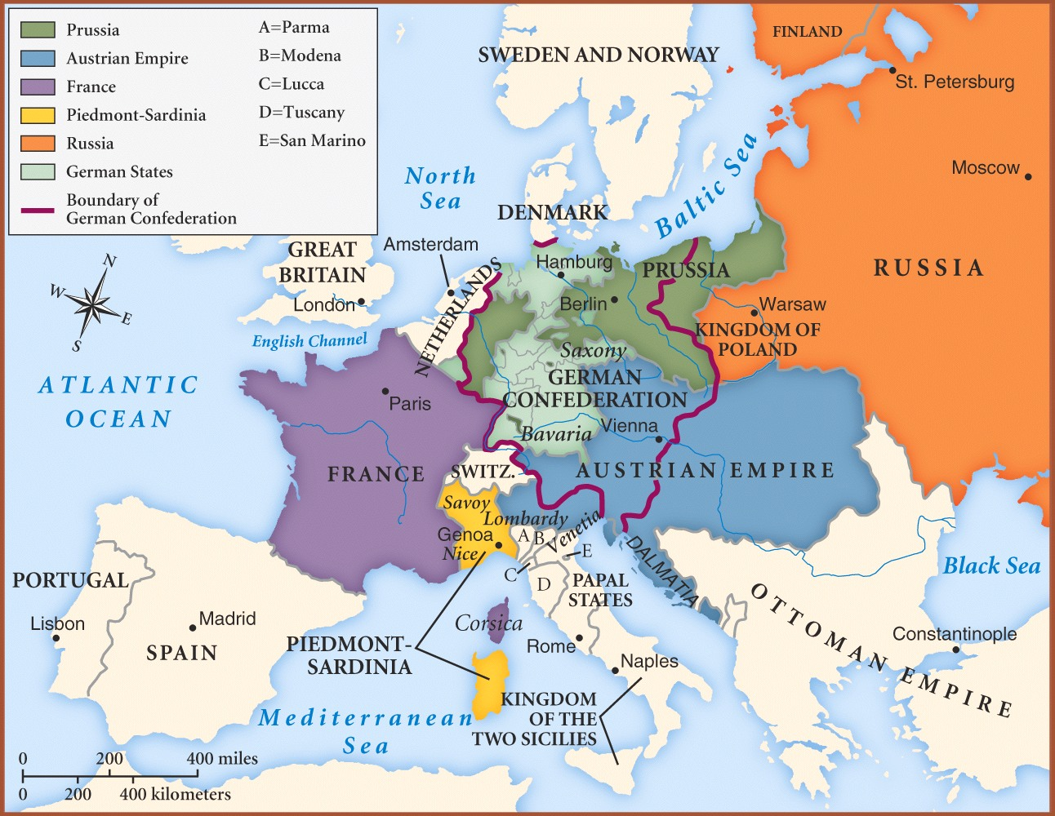

Slide 5
Revolutionary Waves of 1820-1830’s
Clear ideologies of liberalism and nationalism (thanks French Revolution) are spread, and are alive and well - (thanks Industrial Revolution)
Liberalism - favors freedom in both politics and economics
Natural Rights - essential
Representative Government - essential (male property owners to vote)

Slide 6
Nationalism
Belief in community with common traditions, languages, and customs
Threatened the Status Quo in Germany, Italy, and multi-ethnic Austrian Empire
Failed in Revolutions in: Poland, Russia, Italy, and Germany
Successful Reforms in Britain and Revolutions in Greece, France, and Belgium - showed strength in possibility to change

Slide 7
1848 - More Revolutions
Throughout Europe - try and fail…
Republic with Universal Manhood Suffrage was est. in France - but a conflict between socialists and republican political agenda, but failed
Frankfurt Assembly - worked to create a unified Germany, but failed
Austria - liberal demands of Hungarians and other nationalities failed
Italy - uprisings against Austrian rule failed
Eventually they would succeed, with idealistic liberals and nationals, 2nd half of 19th century (1800’s)

Slide 8
What Else Happened?
Disorder lead to European states to create civilian police forces
Cultural impact - Romanticism - reactions, favored intuition, feeling, emotion, which became evident in poetry, literature, art, music
Challenged the Enlightenment - use of reason
Individualism - interest in unique traits of a person
Key Figures: Edgar Allen Poe, Ludwig van Beethoven, Walter Scott
Created a revival in religion and renewed interest of Catholicism and a Protestant “awakening”

