Slide 1
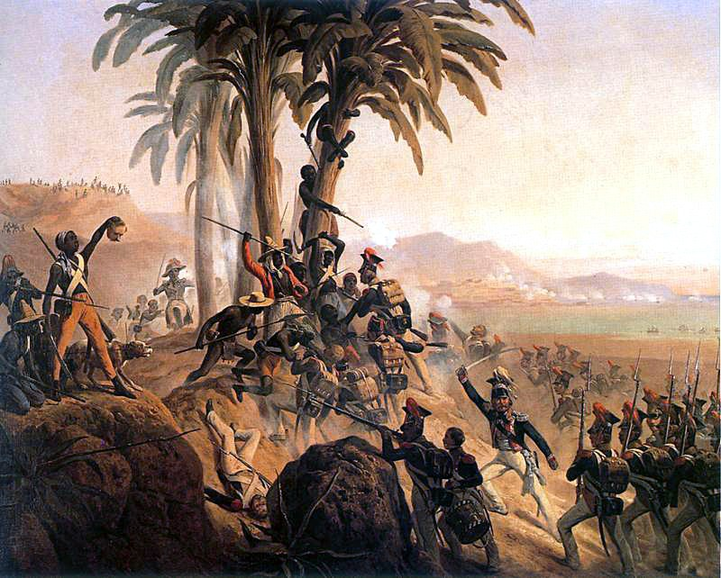
Transatlantic Revolutions
The fever of revolution spreads to the New World

Slide 2
Impact of the Enlightenment, American & French Revolutions
Ideas of the Enlightenment come to Americas around the same time as Europe
Rich peninsulars (Spanish Born, living in New World/E. Indies) & creoles (born in the West Indies or Spanish America but of European, usually Spanish, ancestry) were famously “slaves” to European fashion, ideas, culture, etc. until well into the 20th century
Intellectual atmosphere was one that wanted a move free society, looser caste system, end to slavery, etc., but never really had the stomach to do it
This was true: for economic needs (who would produce our resources?),
social (we like having money)
political reasons (church and state tied in Spain so Enlightenment always goes through religion)
American Revolution shows that it is possible for colonies to through off yoke of colonial power & have popular sovereignty
French Revolution perpetuates the idea that Europeans are ready for Enlightenment ideals

Slide 3
Causes/Effect
Long Term | Immediate
European Domination | Social Injustices
Spread of Enlightenment Ideas | Revolutionary Leaders emerge
American and French revolutions | Napoleon invades Spain
Growth of nationalism

Slide 4
Timeline of Revolutions

Slide 5
Independence Movements
Immediate Effects | Long Term Effects
Toussaint L’Ouveture leads SLAVE REVOLT in Haiti – 1791 from France | Numerous independent nations emerge in Latin America
Simon Bolivar, a Creole, 1810 war for Venezuela and Jose de San Martin help liberate Chile, Peru, and Argentina | Continuing efforts to achieve stable democratic governments and to gain economic independence
Colonial Rule Ends in much of Latin America

Slide 6
Map
KEY PLAYERS:
Spanish
Portuguese
British
Dutch
French

Slide 7
Map #2

Slide 8
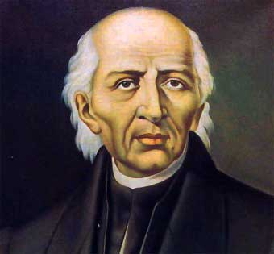
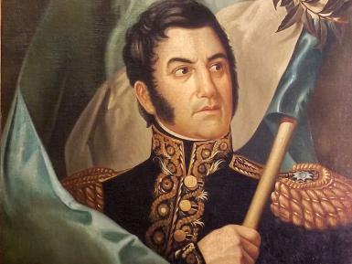
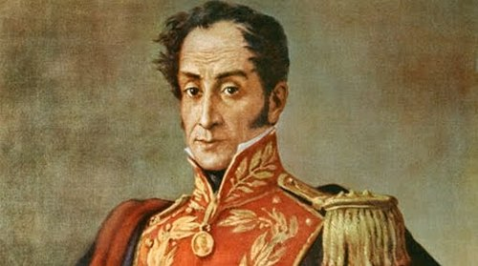
Key Leaders
Father Miguel Hidalgo
Simon Bolivar and Jose de San Martin

Slide 9
Summary of Big Ideas

Slide 10
Homework
628 – The Revolt of Latin America to 630, stop before The Greek Revolt = brief notes/summary for tomorrow. Look closely at the map, 21.2 – what can we learn from this map?
634- The Ideologies of Change to 638 – Stop at Revolutions and Reform –DUE FRIDAY

